Slide 1
Using the MATLAB Distributed Computing Toolbox on Multiprocessor Machines

Slide 2
Basic DCT Model
Scheduler
(MATLAB Job
Manager or
other)
Worker
(DCE)
MATLAB Client
(DCT)
Worker
(DCE)
Worker
(DCE)
Worker
(DCE)

Slide 3
Basic DCT Model
Scheduler
(MATLAB Job
Manager or
other)
Worker
(DCE)
MATLAB Client
(DCT)
Worker
(DCE)
Worker
(DCE)
Worker
(DCE)

Slide 4
Local DCT
MATLAB Client
Operating
System
Processor
(Hardware)
Worker
Process
Processor
(Hardware)
Worker
Process
Local Scheduler
Processor
(Hardware)
Worker
Process
Worker
Process
Processor
(Hardware)

Slide 5
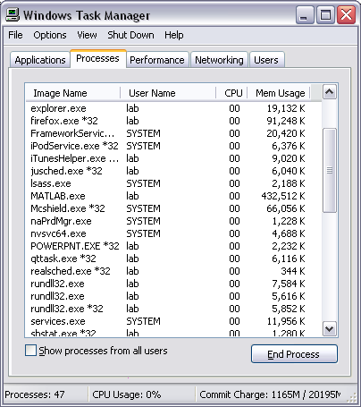
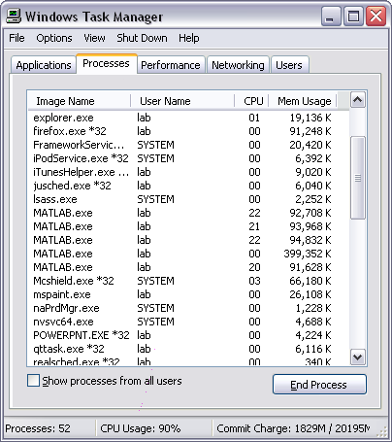
Workers Run as Separate Processes

Slide 6
DCT Jobs and Tasks
Job: Main problem to be solved
  Example: Analyze a session of multichannel electrode data
  Or: Analyze many sessions of multichannel electrode data
Task: Independent subproblems composing job
  Examples: Compute cross-spectra of all channel pairs, compute BLP of various bandranges, compute cross-spectra of BLPs…
  Or: Analyze one session of multichannel electrode data

Slide 7
Choosing Your Job and Tasks
Is my problem a good candidate for distributed computing?
    Most likely case: there is a big for loop with independent iterations
What should be my “job”?
    The part of your code represented by the for loop is a good candidate.
What should be my “tasks”?
    Each iteration of the for loop is a good candidate.

Slide 8
Example: Defining Job and Tasks
Suppose you have this MATLAB code:
function [blps, crossSpectra] = getBLPSpectra(lfp)
blpRanges = getBLPRanges;
blps = cell(size(blpRanges));
crossSpectra = cell(size(blpRanges));
for k=1:length(blpRanges)
blps{k} = computeBLP(lfp,blpRanges{k});
crossSpectra{k} = computeCrossSpectra(blps{k});
end

Slide 9
Example: Defining Job and Tasks
Suppose you have this MATLAB code:
function [blps, crossSpectra] = getBLPSpectra(lfp)
blpRanges = getBLPRanges;
blps = cell(size(blpRanges));
crossSpectra = cell(size(blpRanges));
for k=1:length(blpRanges)
blps{k} = computeBLP(lfp,blpRanges{k});
crossSpectra{k} = computeCrossSpectra(blps{k});
end
Your Job

Slide 10
Example: Defining Job and Tasks
Convert it to this MATLAB code:
function job = DCT_getBLPSpectra(lfp, sched)
blpRanges = getBLPRanges;
job = createJob(sched);
for k=1:length(blpRanges)
createTask(job, @computeBLPandCrossSpectra, 2, ...
{lfp, blpRanges{k}});
end
submit(job);
function [blp, crossSpectra] = ...
computeBLPandCrossSpectra(lfp,blpRange)
blp = computeBLP(lfp,blpRange);
crossSpectra = computeCrossSpectra(blp);

Slide 11
Example: Defining Job and Tasks
Convert it to this MATLAB code:
function job = DCT_getBLPSpectra(lfp, sched)
blpRanges = getBLPRanges;
job = createJob(sched);
for k=1:length(blpRanges)
createTask(job, @computeBLPandCrossSpectra, 2, ...
{lfp, blpRanges{k}});
end
submit(job);
function [blp, crossSpectra] = ...
computeBLPandCrossSpectra(lfp,blpRange)
blp = computeBLP(lfp,blpRange);
crossSpectra = computeCrossSpectra(blp);

Slide 12
Example: Defining Job and Tasks
Convert it to this MATLAB code:
function job = DCT_getBLPSpectra(lfp, sched)
blpRanges = getBLPRanges;
job = createJob(sched);
for k=1:length(blpRanges)
createTask(job, @computeBLPandCrossSpectra, 2, ...
{lfp, blpRanges{k}});
end
submit(job);
function [blp, crossSpectra] = ...
computeBLPandCrossSpectra(lfp,blpRange)
blp = computeBLP(lfp,blpRange);
crossSpectra = computeCrossSpectra(blp);

Slide 13
Example: Defining Job and Tasks
Convert it to this MATLAB code:
function job = DCT_getBLPSpectra(lfp, sched)
blpRanges = getBLPRanges;
job = createJob(sched);
for k=1:length(blpRanges)
createTask(job, @computeBLPandCrossSpectra, 2, ...
{lfp, blpRanges{k}});
end
submit(job);
function [blp, crossSpectra] = ...
computeBLPandCrossSpectra(lfp,blpRange)
blp = computeBLP(lfp,blpRange);
crossSpectra = computeCrossSpectra(blp);

Slide 14
Invoking Your Job
>> sched = findResource('scheduler', 'type', 'local');
>> job = DCT_getBLPSpectra(lfp, sched);
Now you can return to your life and even use your MATLAB client as you normally would. To check the status of your job, use the following command:
>> findTask(job)
ans =
Tasks: 4 by 1
=============
Task ID State End Time Function Name Error
----------------------------------------------------------
1 finished Aug 03 12:20:14 @myTaskFunc
2 running @myTaskFunc
3 running @myTaskFunc
4 finished Aug 03 12:30:28 @myTaskFunc

Slide 15
Getting the Output of Your Job
When your job is finished, retrieve your data with the following command:
>> outputs = getAllOutputArguments(job);
>> blps = outputs(:,1);
>> crossSpectra = outputs(:,2);
And when you’re sure you’ve got all your data, make sure to clean up after yourself:
>> destroy(job)

Slide 16
Caveat
The example here was probably a bad choice (for any reasonably sized LFP data) due to MATLAB’s parameter passing technique
MATLAB may create large temporary files; be sure to have plenty of disk space
A better solution might be something like:
job = createJob(sched);
job.JobData = lfp;
for k=1:length(blpRanges)
createTask(job, @computeBLPandCrossSpectra, 2, ...
{blpRanges{k}});
end
function [blp, crossSpectra] = ...
computeBLPandCrossSpectra(blpRange)
job = getCurrentJob;
lfp = job.JobData;
blp = computeBLP(lfp,blpRange);
crossSpectra = computeCrossSpectra(blp);

